Slide 1
1 ENKA HOMEPAGE

Slide 2
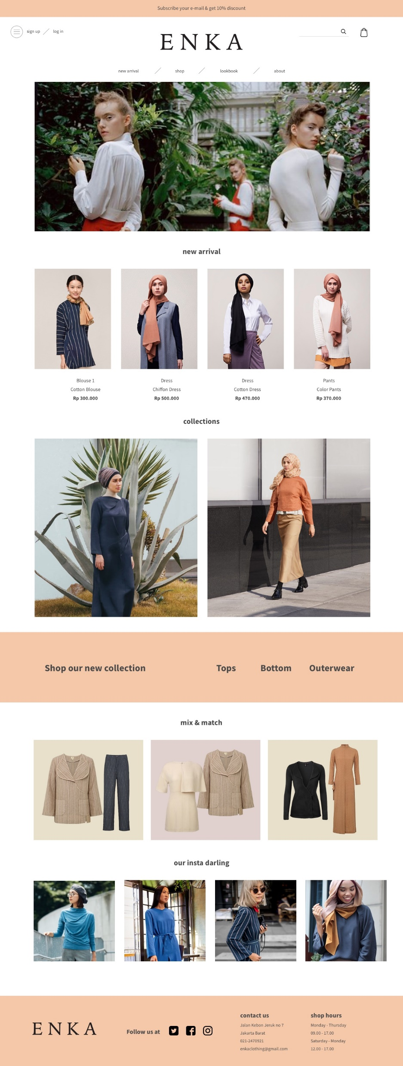

Slide 4
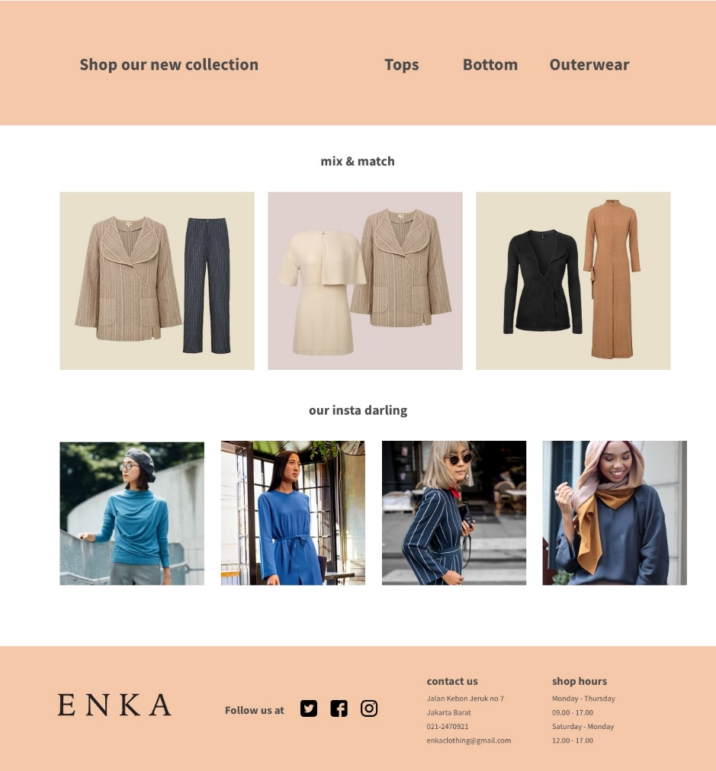

Slide 5
2 ENKA LOOKBOOK

Slide 6
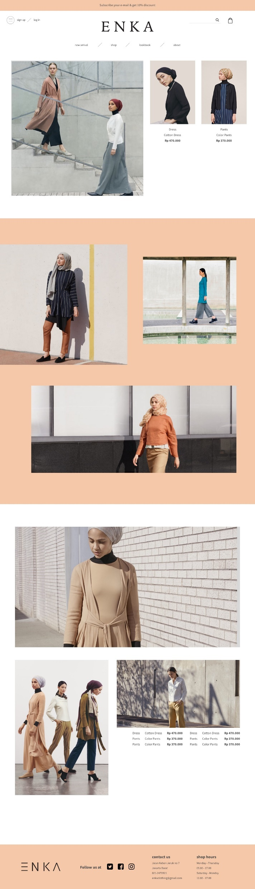


Slide 7


Slide 8


Slide 9
3 ENKA DROPDOWN MENU

Slide 10
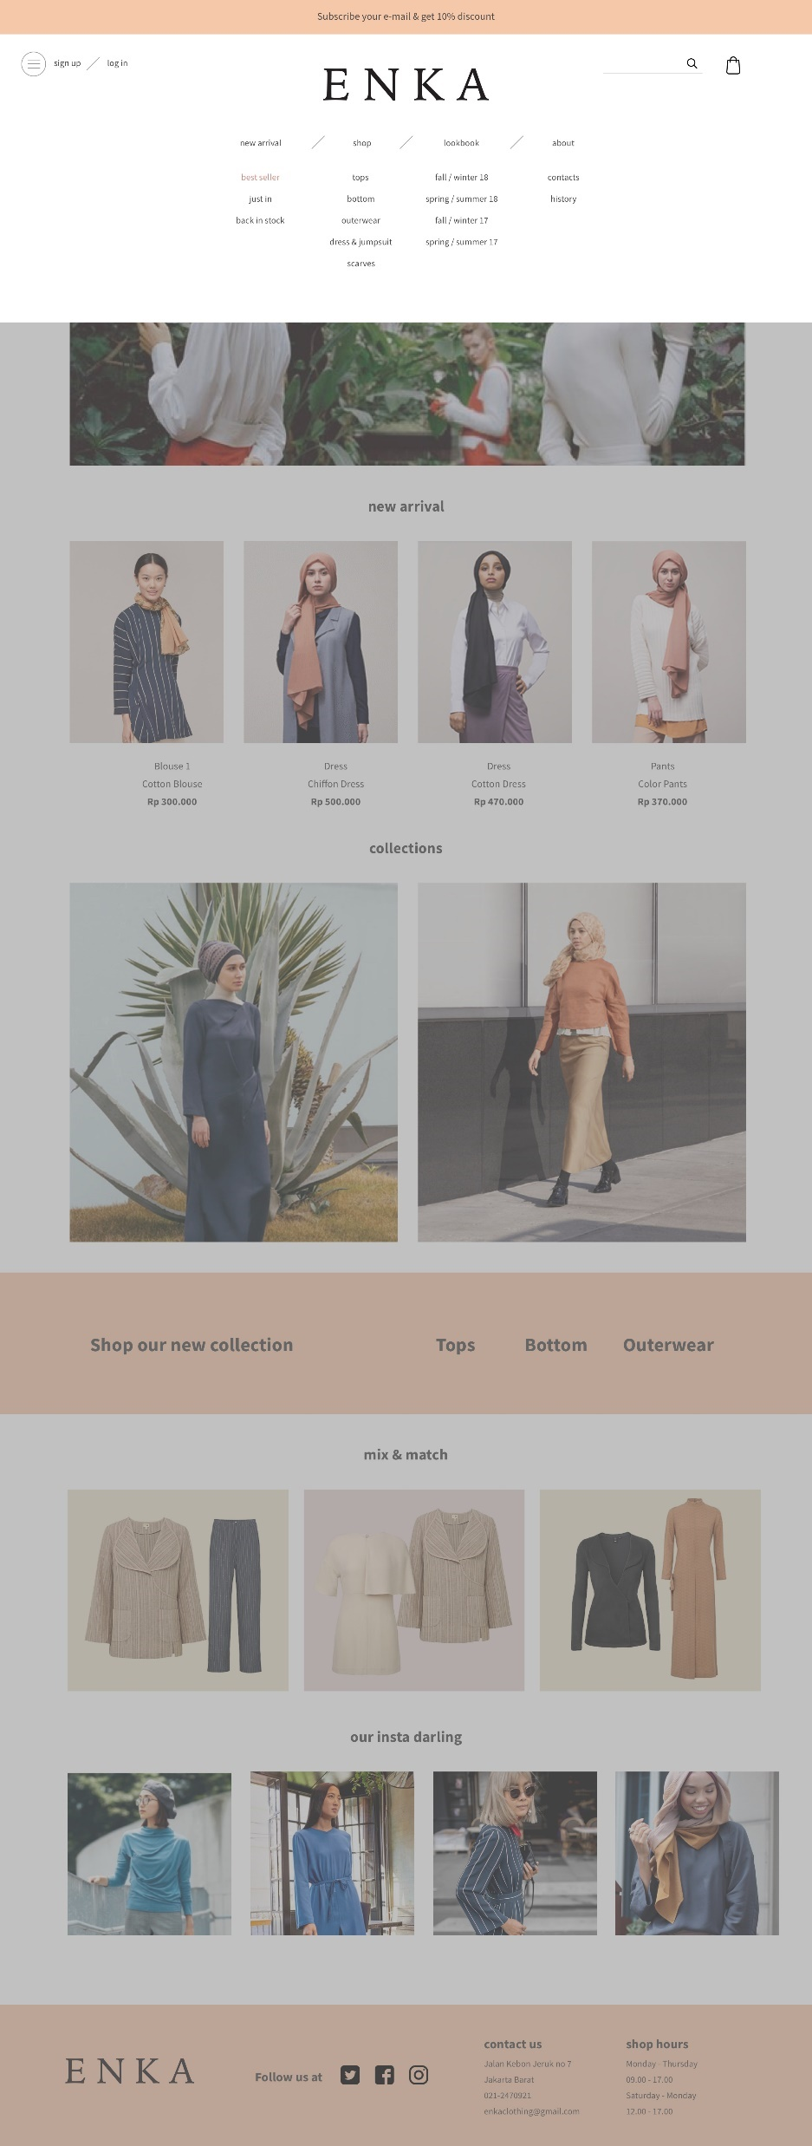


Slide 11



Slide 12
4 ENKA POP UP

Slide 13
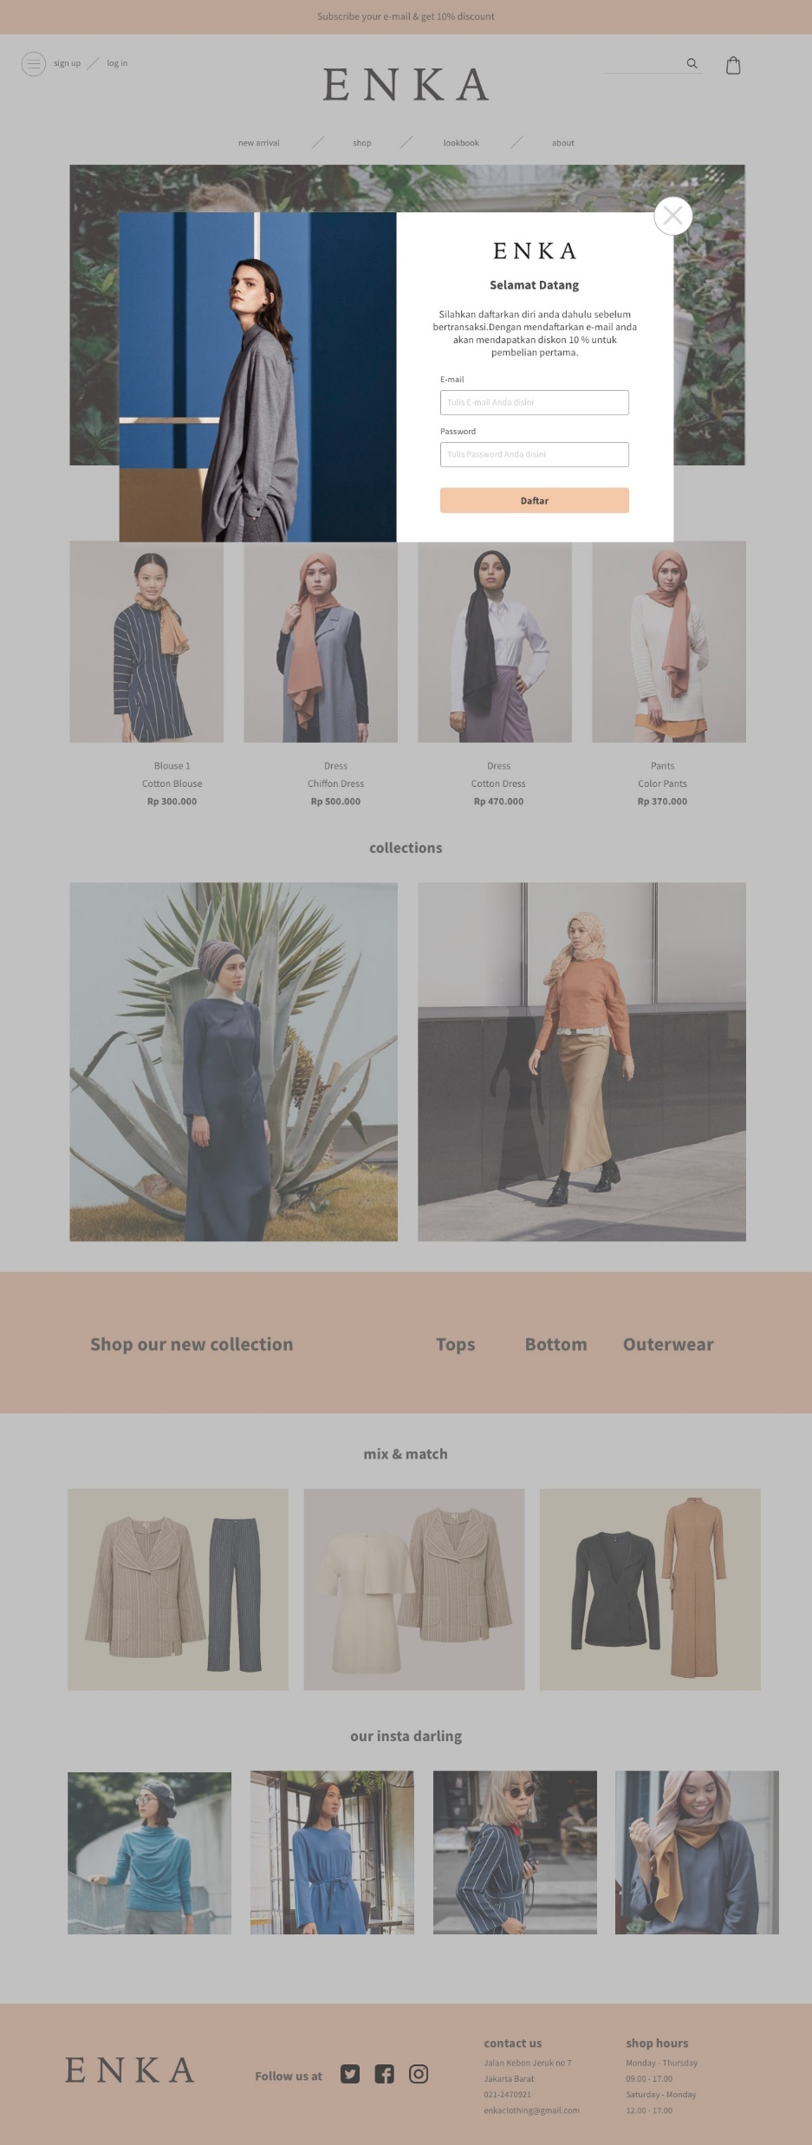

Slide 14
4 ENKA ABOUT US
CONTACT US

Slide 15
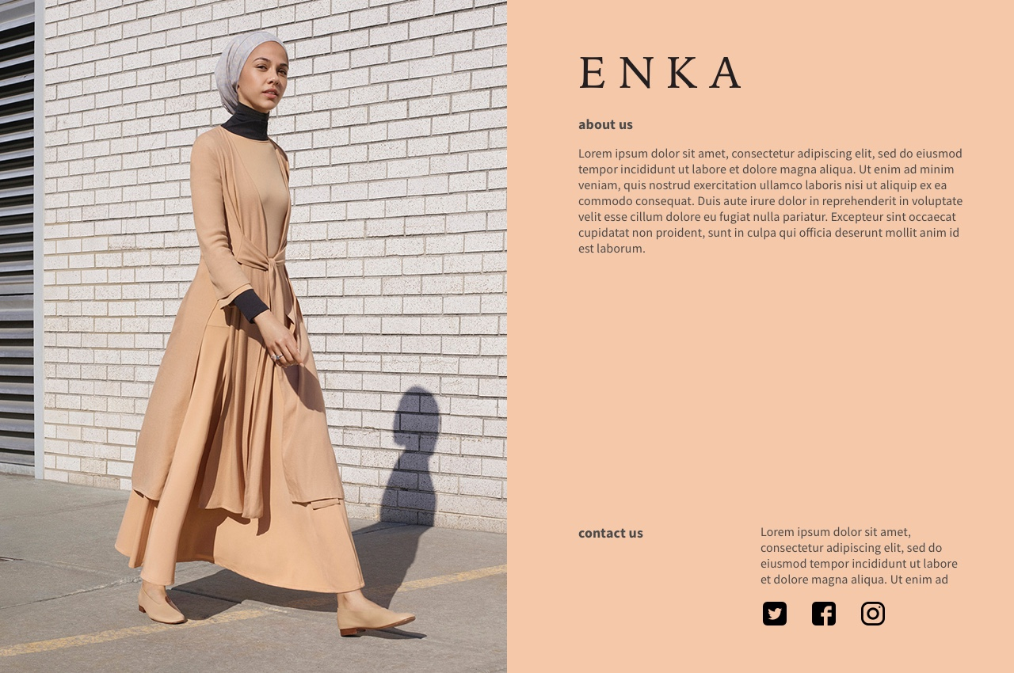

Slide 16
5 STORY ENKA

Slide 17
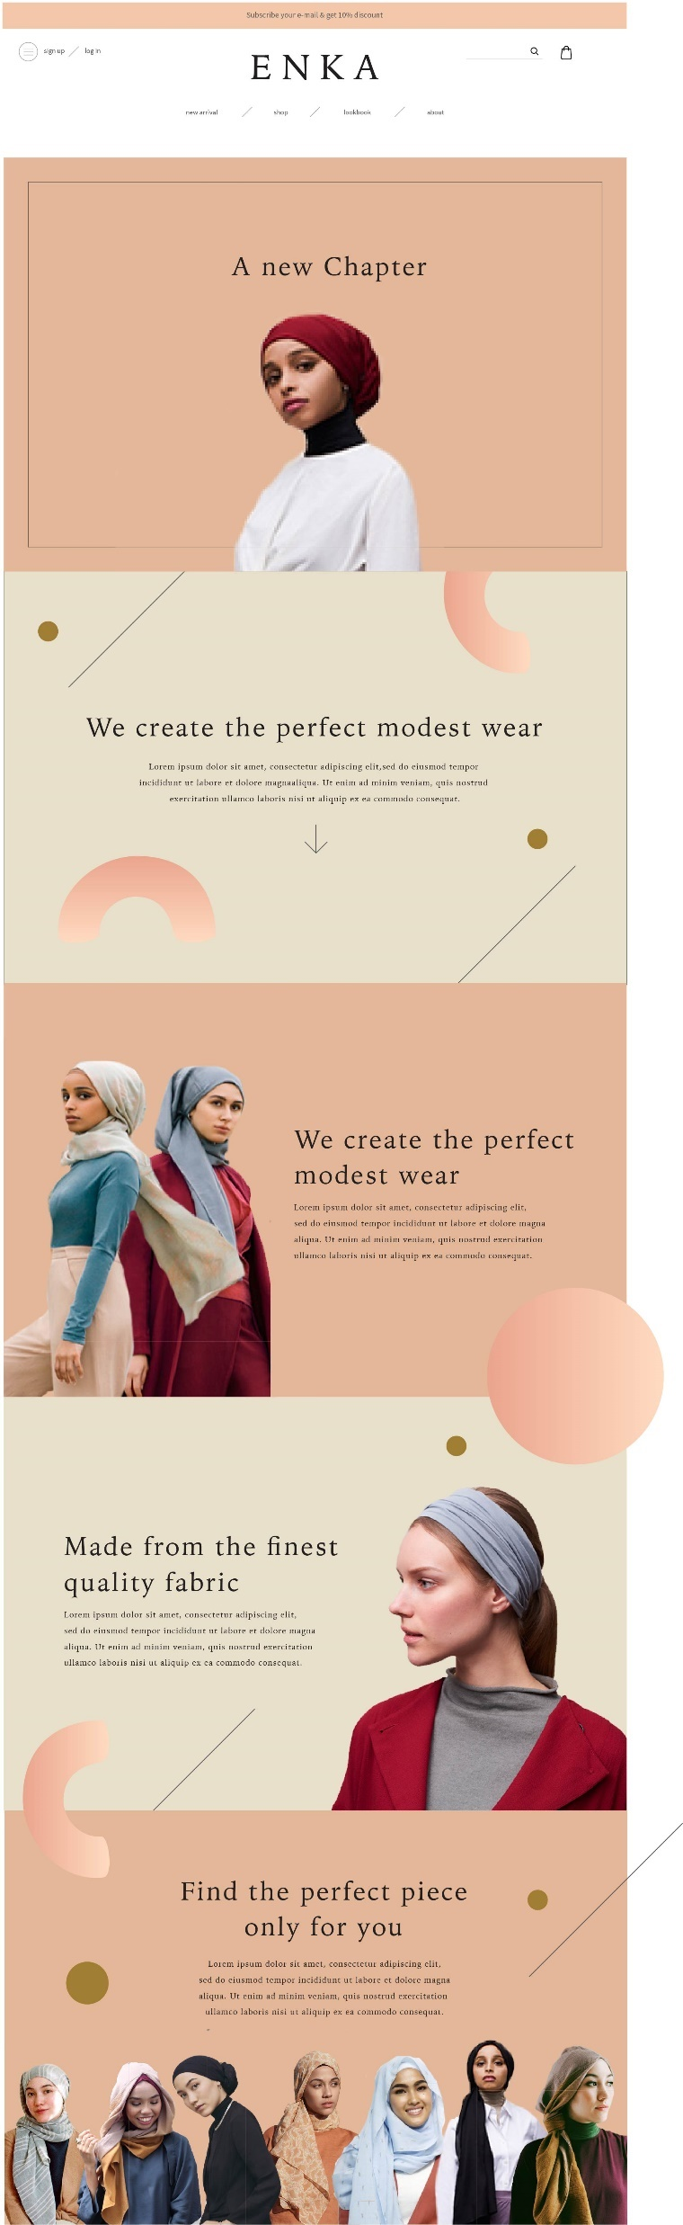


Slide 18


Slide 19


Slide 20


Slide 22
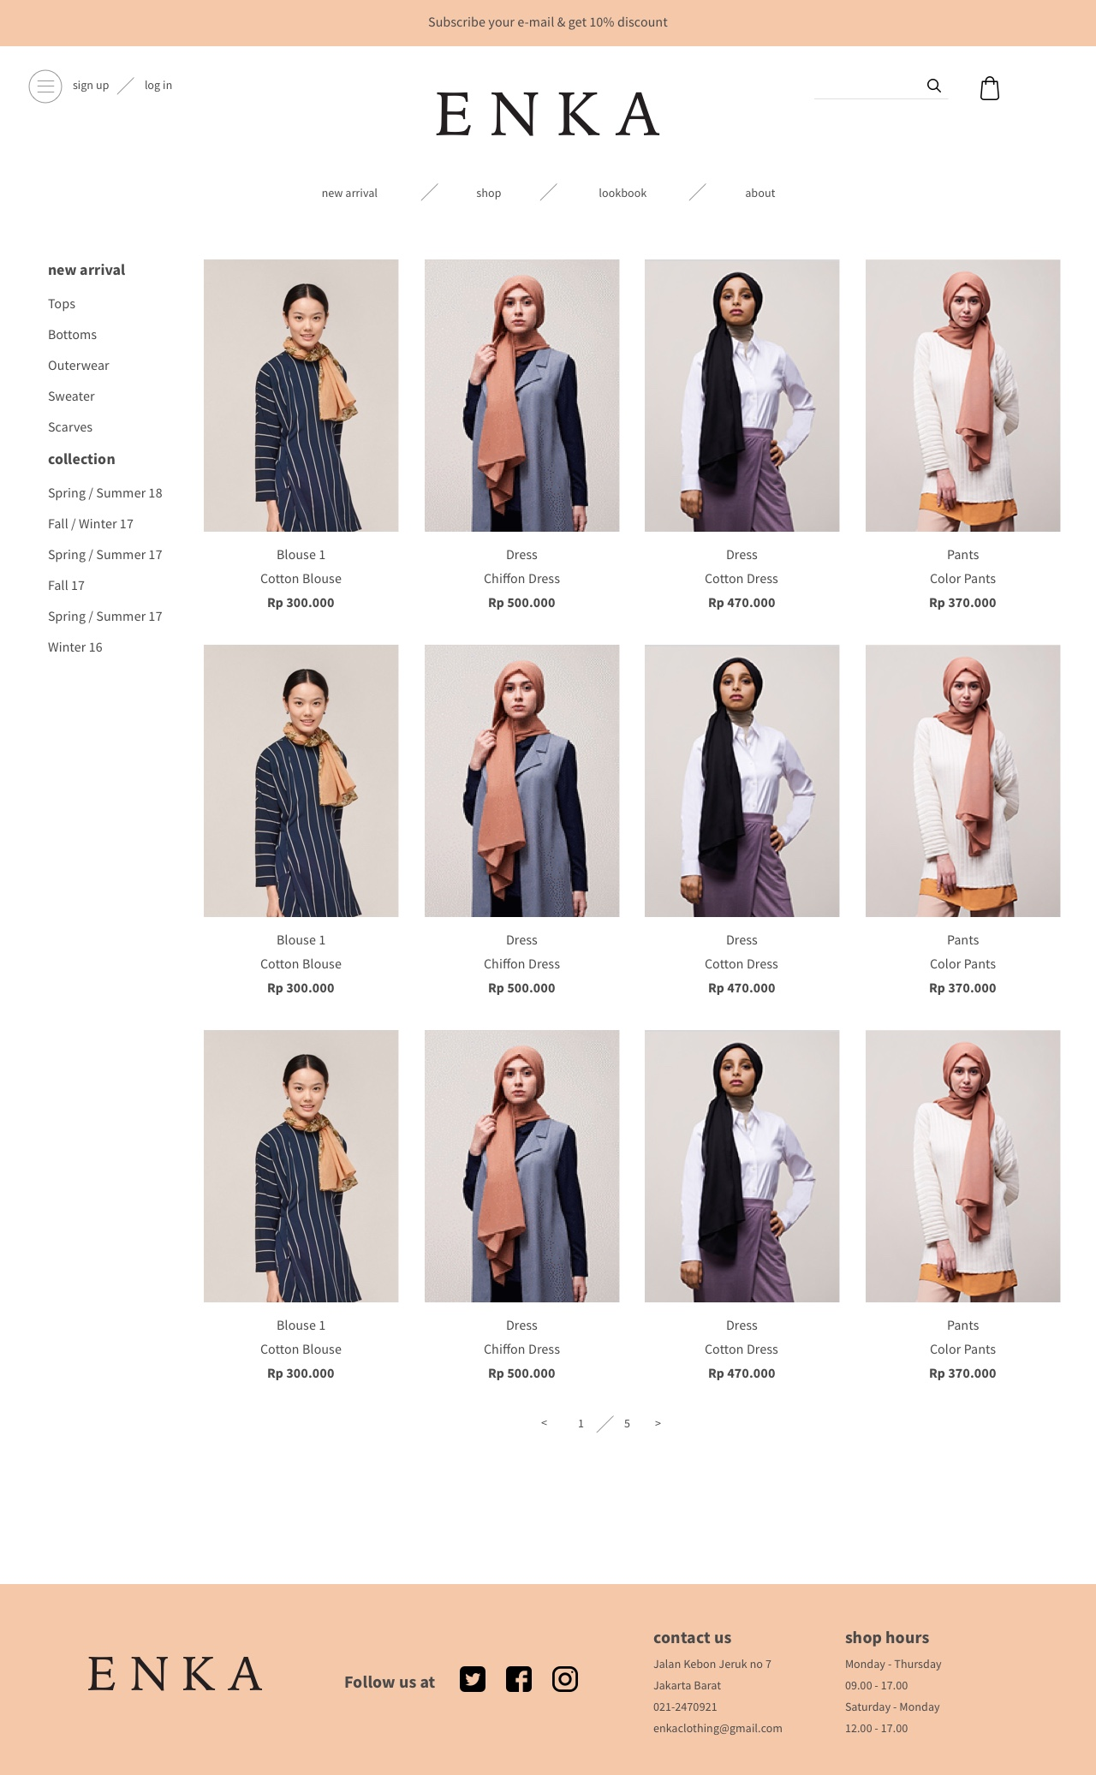
8 ENKA CLOTHES

Slide 23
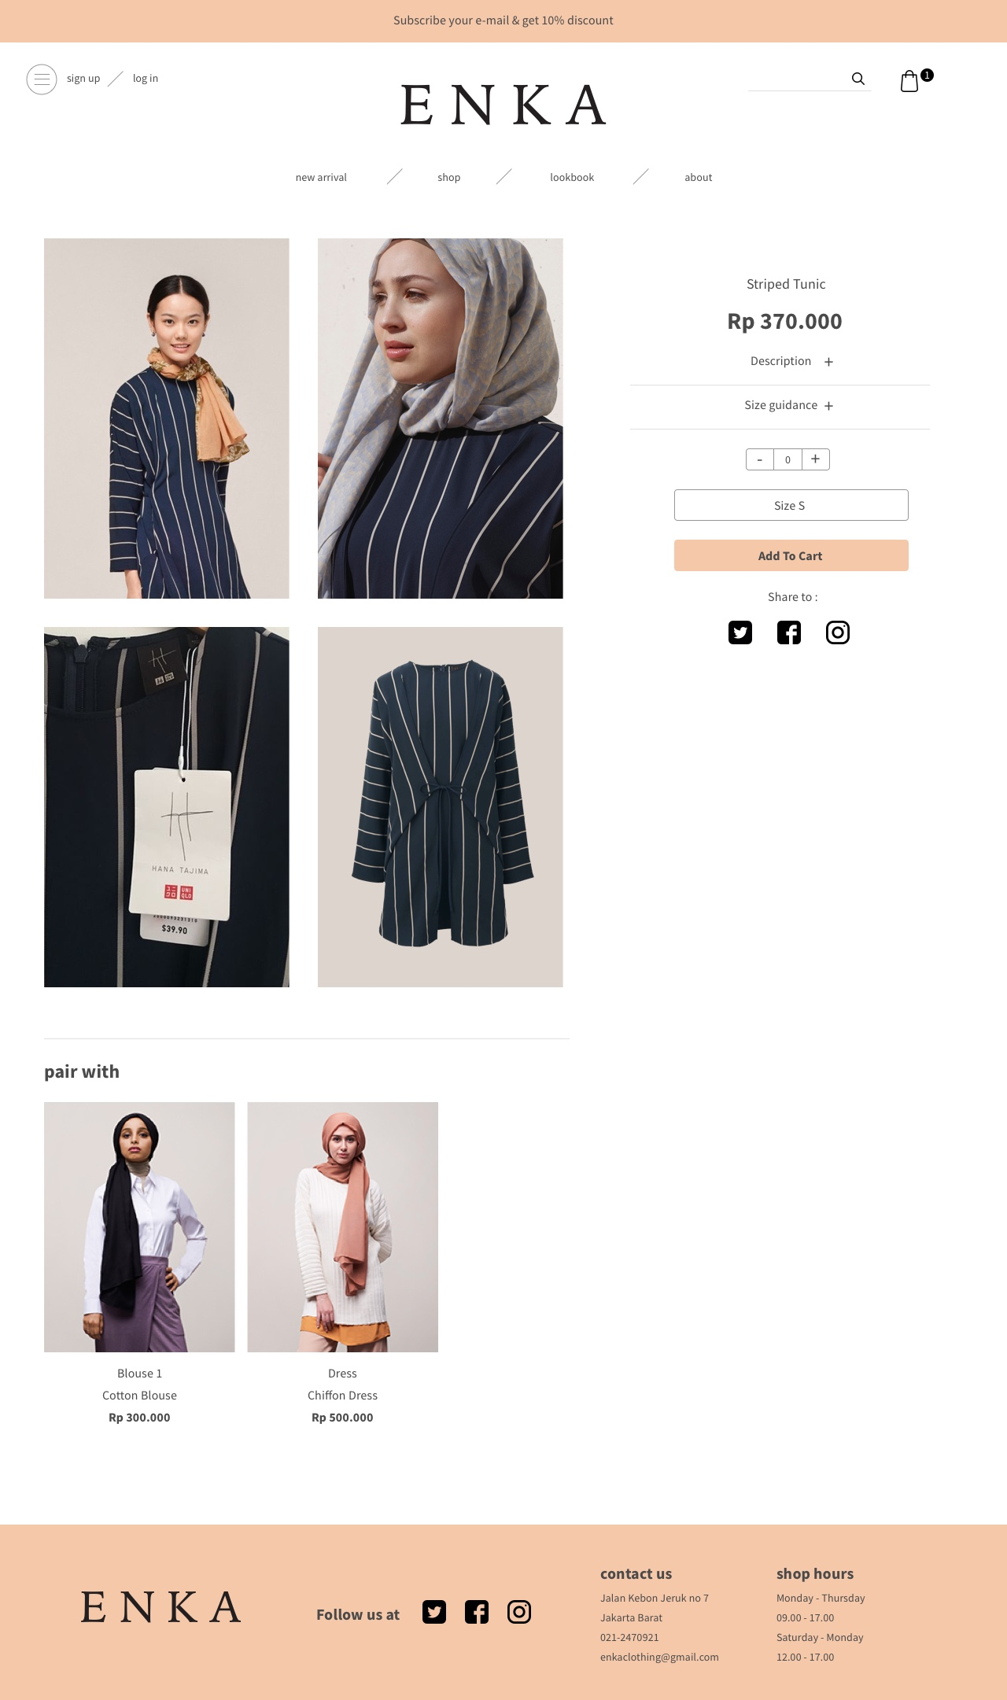
10 ENKA ADD TO CART

Slide 24
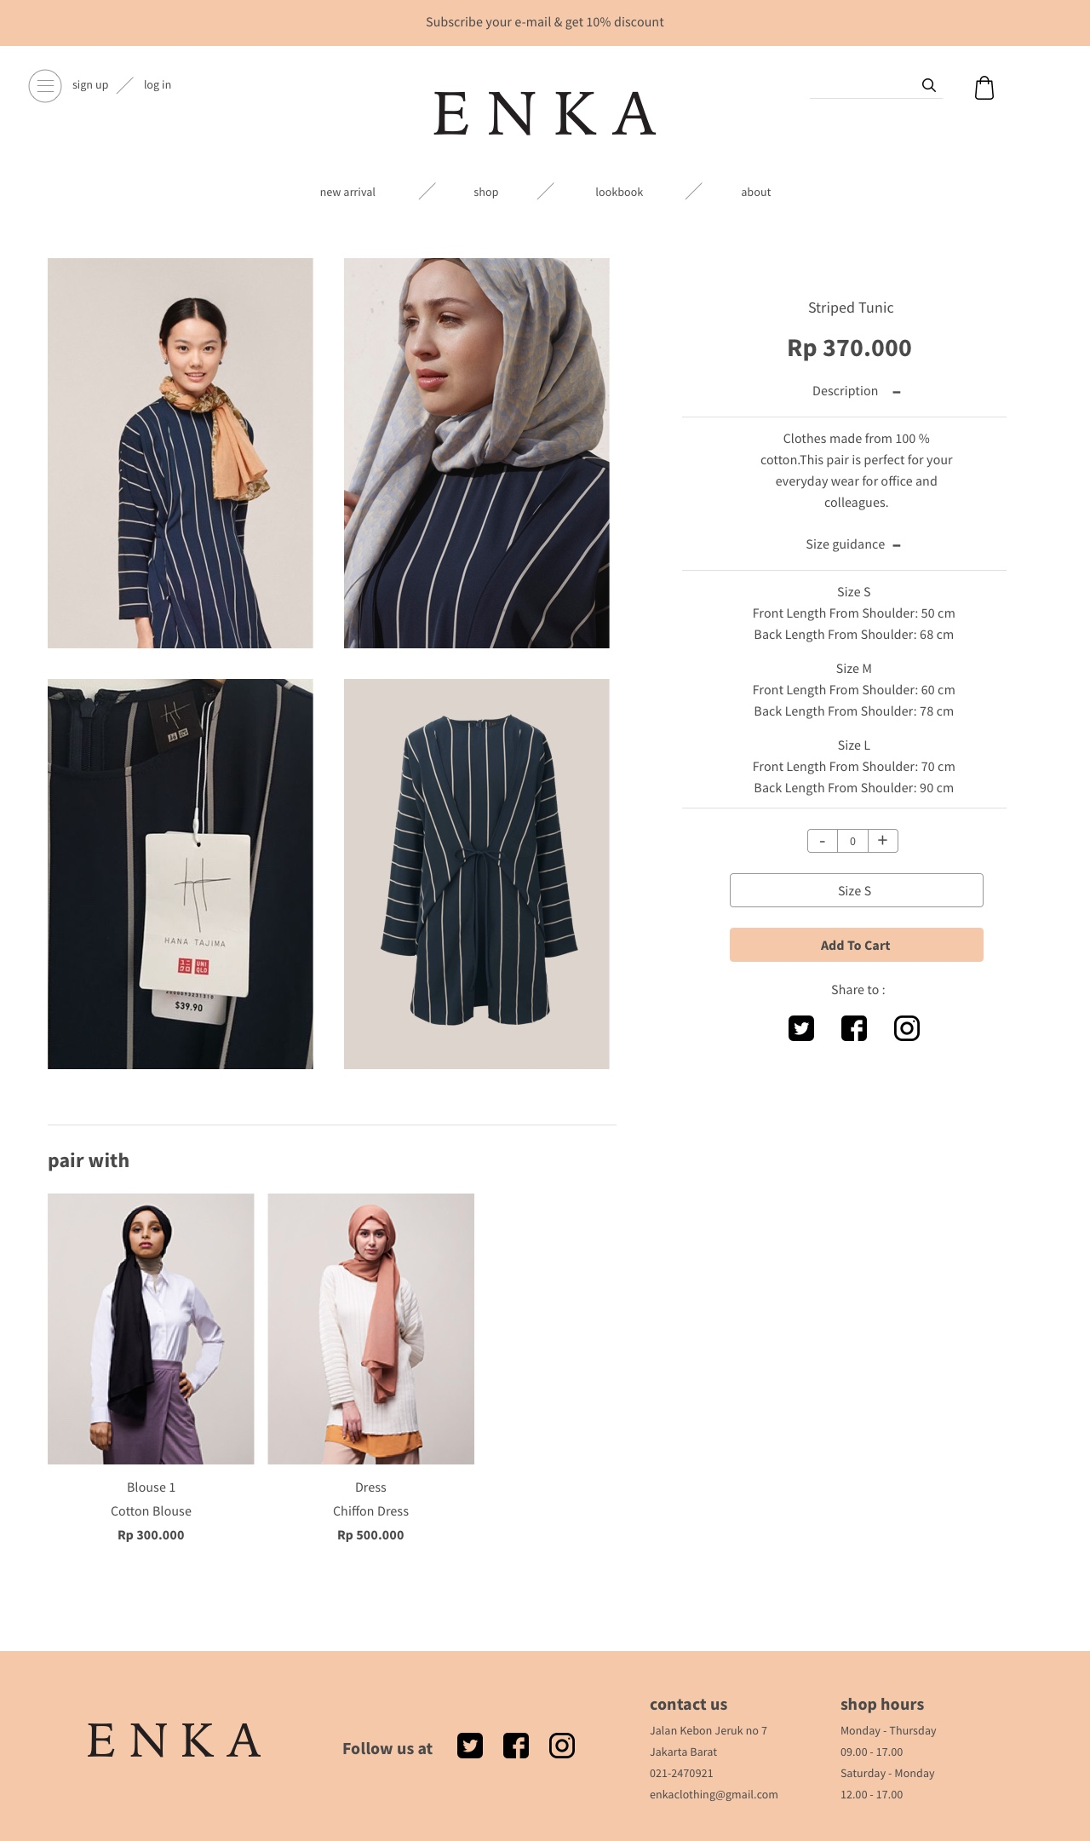
11 ENKA CLOTHES DETAIL DROPDOWN

Slide 25
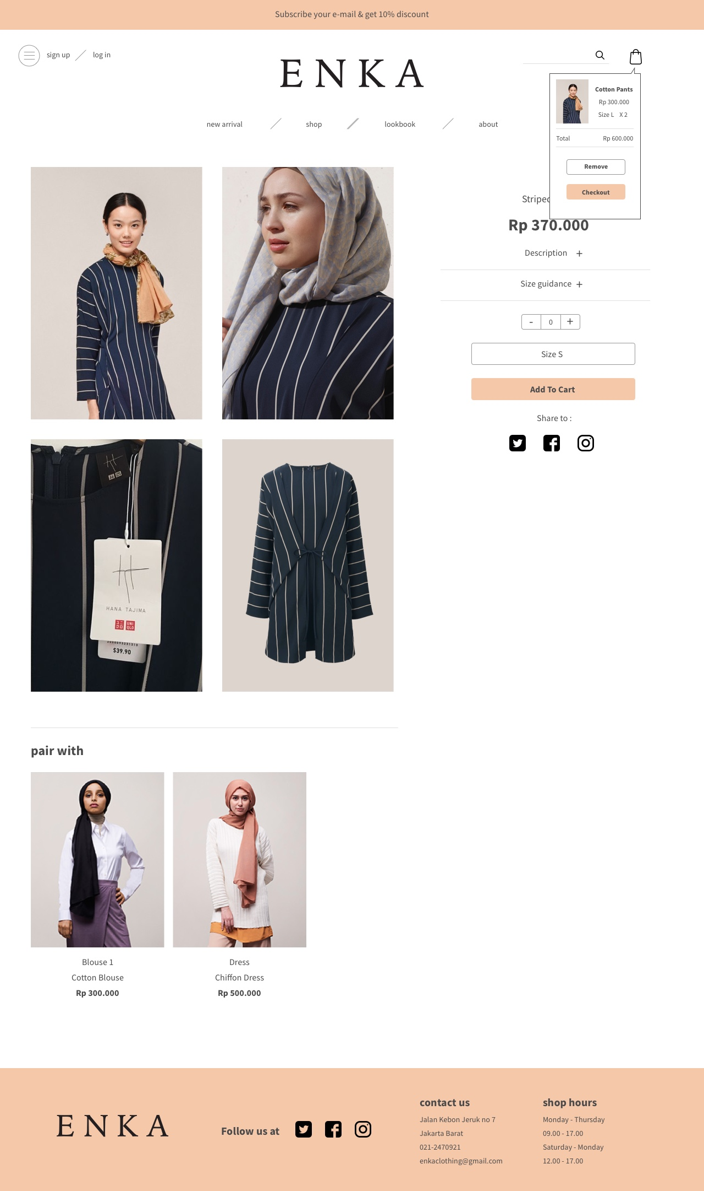
12 ENKA CART DETAIL

Slide 26
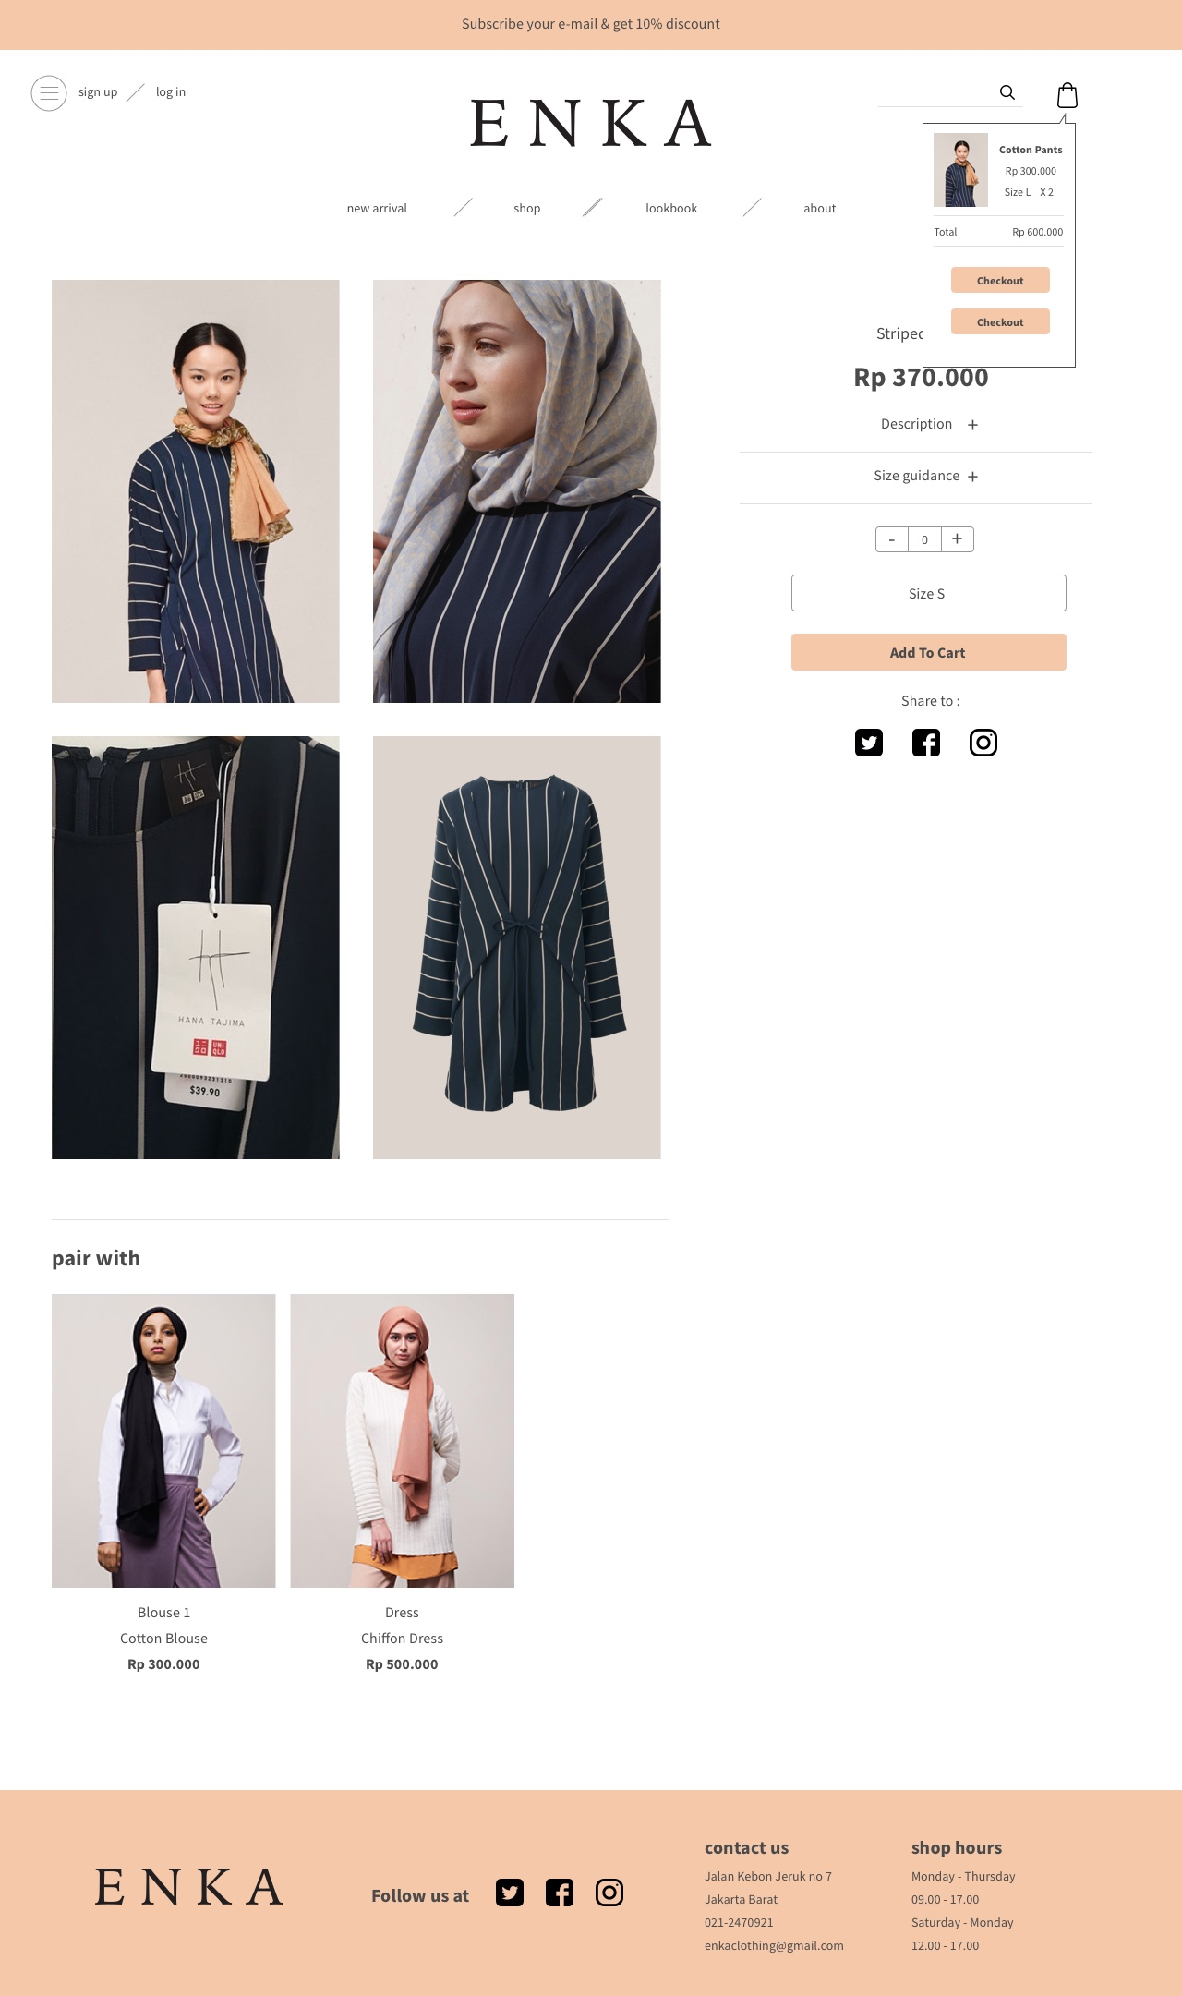
13 ENKA ADD TO CART DETAIL

Slide 27
14 ENKA LOG IN

Slide 28
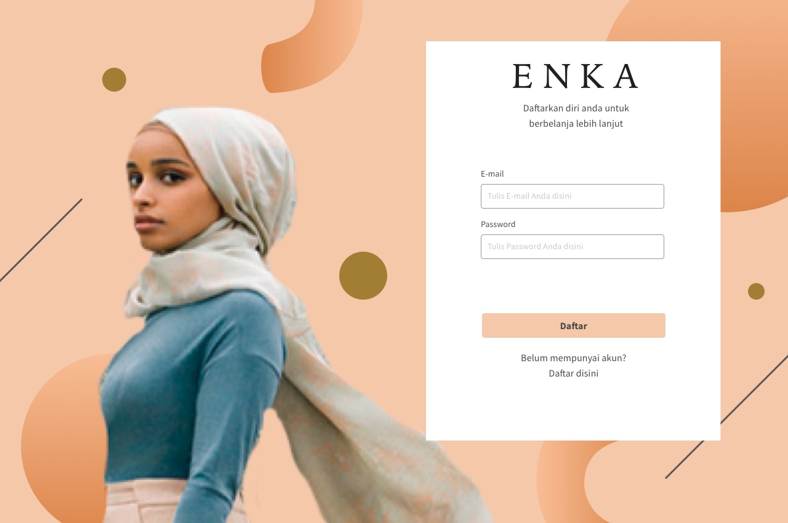

Slide 29
15 ENKA REGISTER

Slide 30
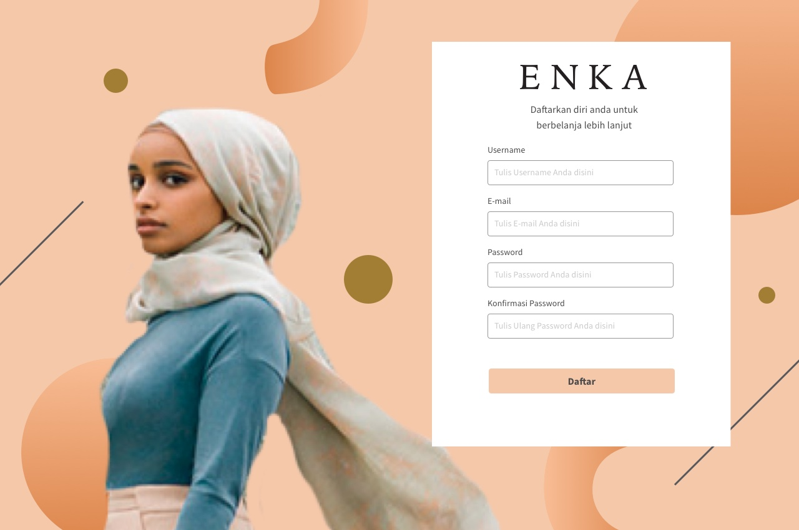

Slide 31
16 ENKA MY ACCOUNT

Slide 32
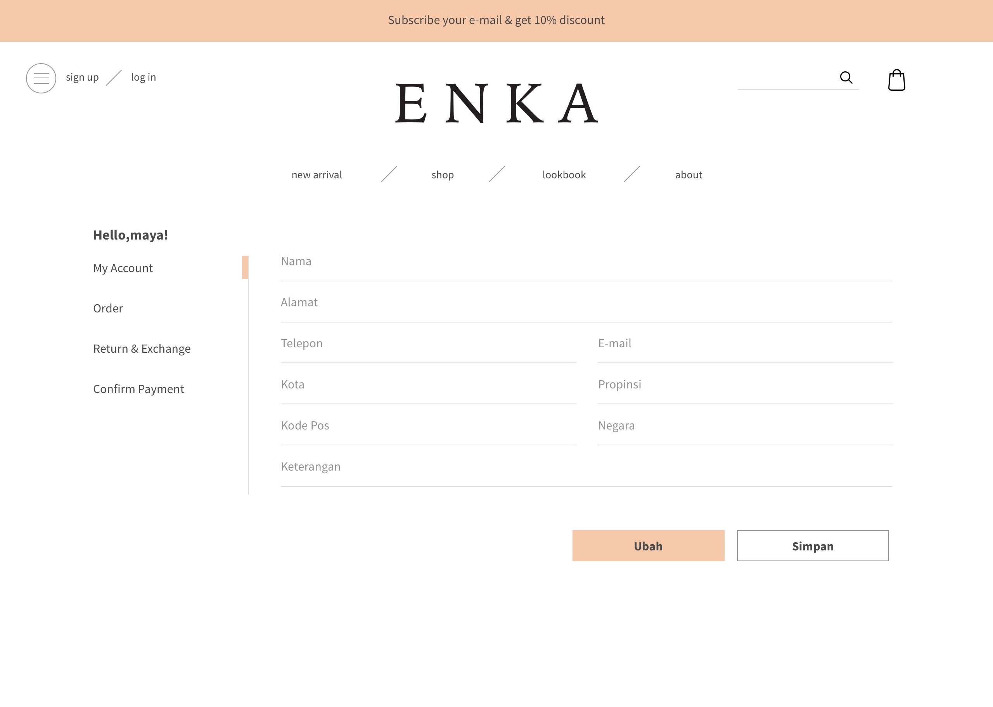

Slide 33
17 ENKA QUOTATION DETAIL

Slide 34
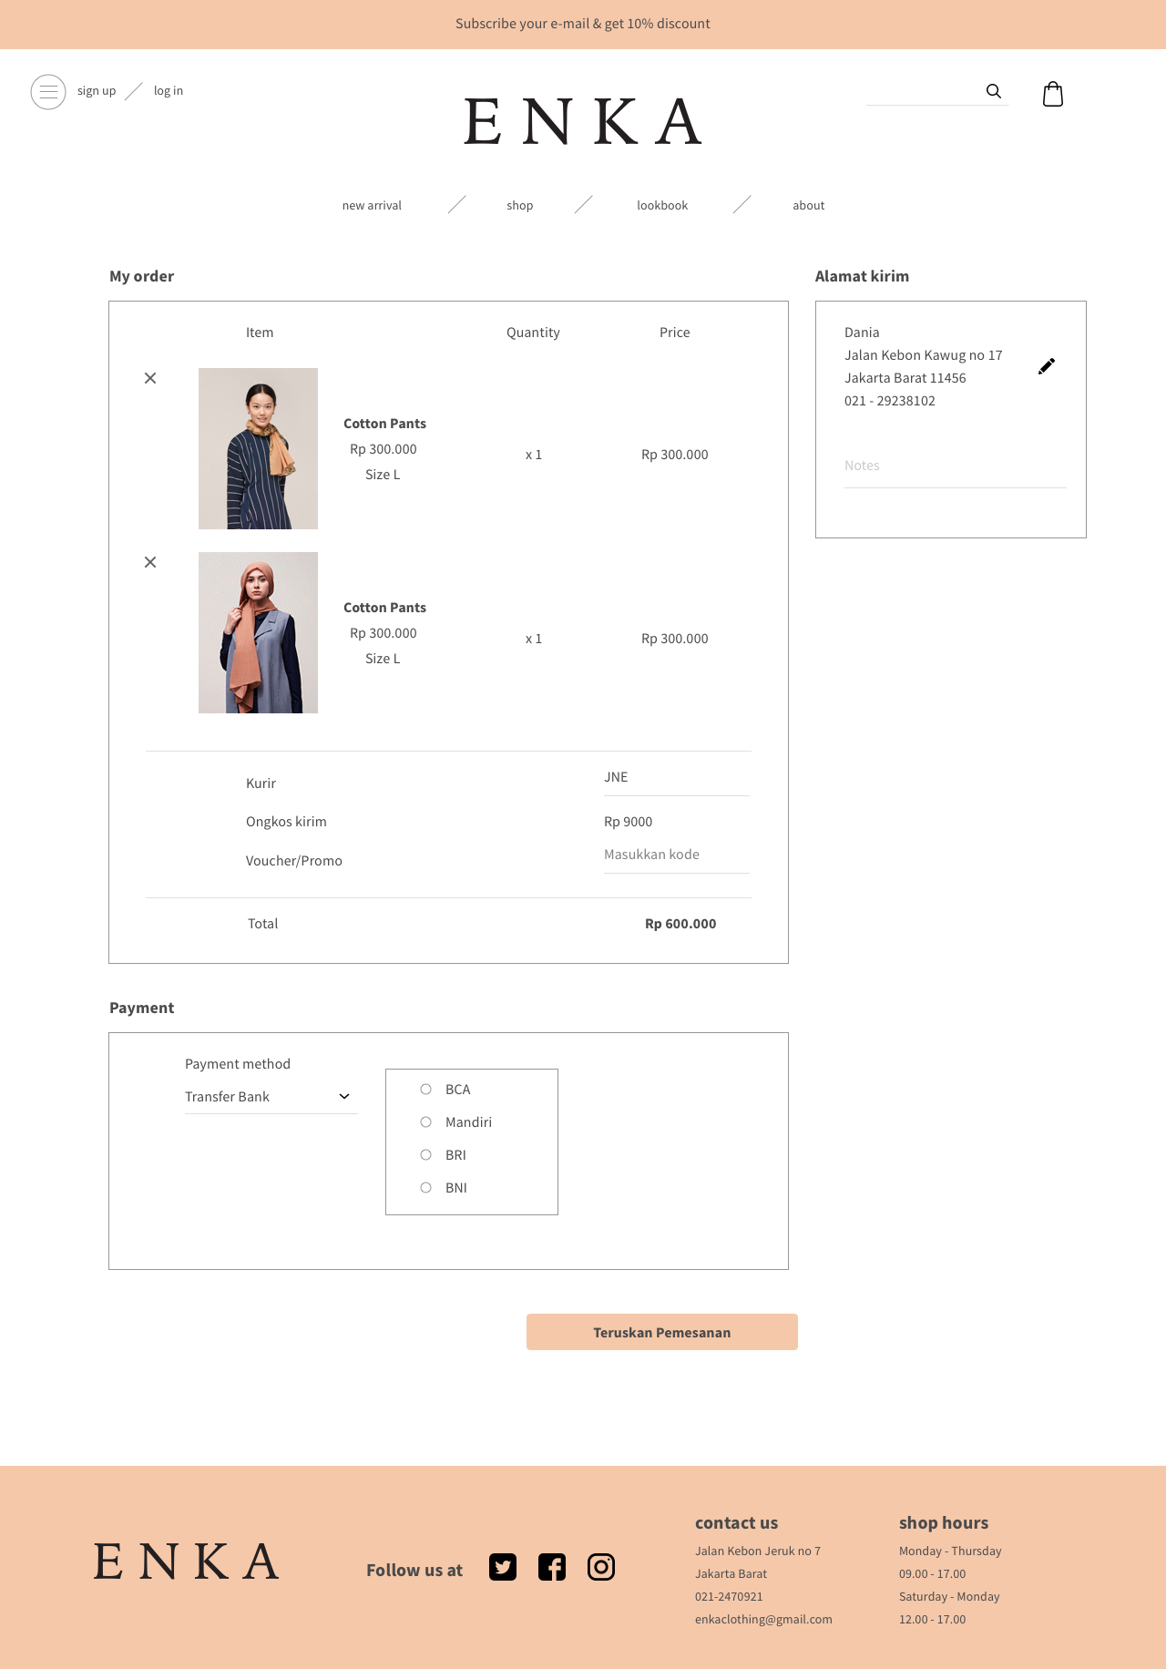

Slide 35
18 ENKA QUOTATION POP UP

Slide 36
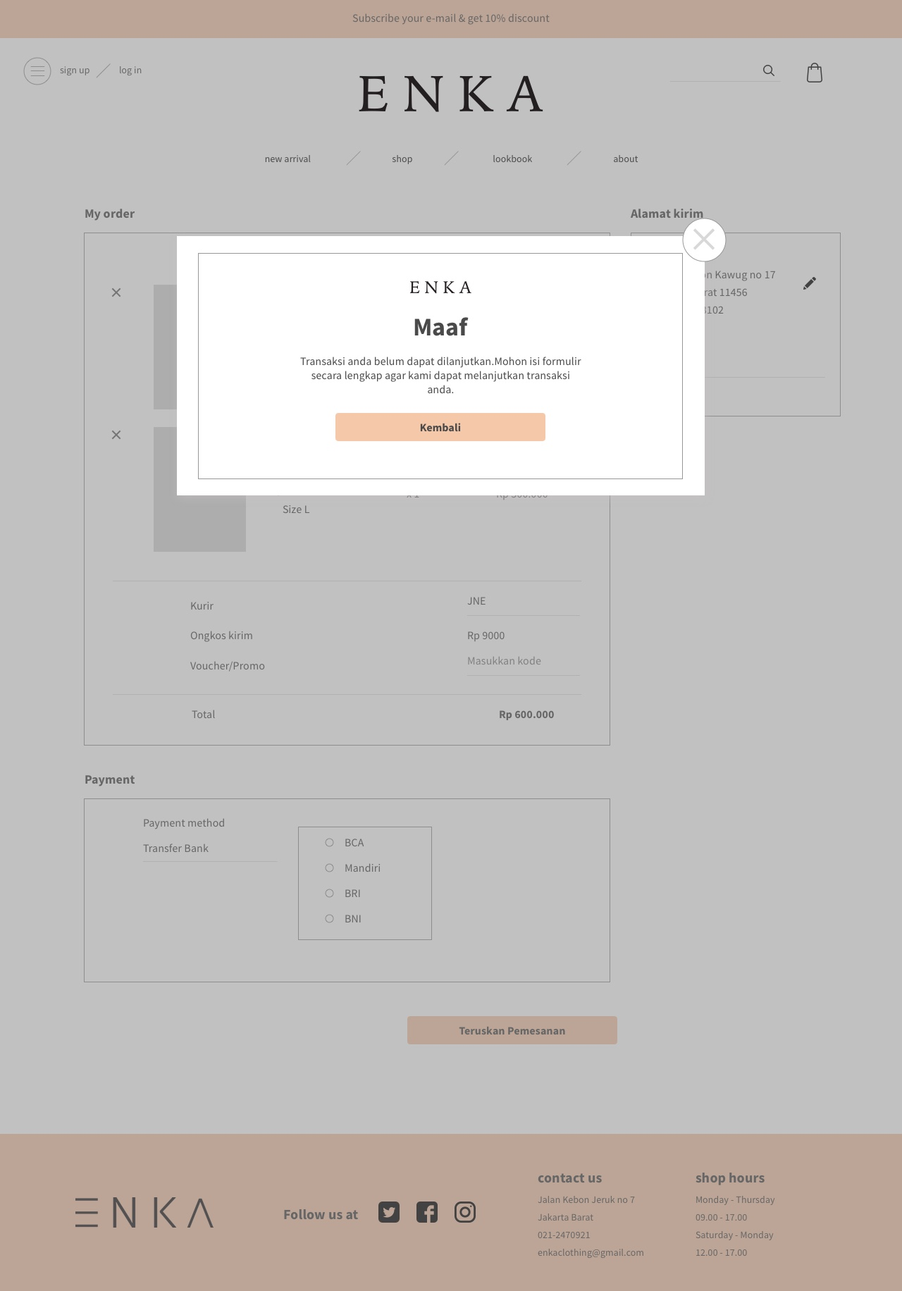

Slide 37
19 ENKA TRANSATION SUCCEED

Slide 38
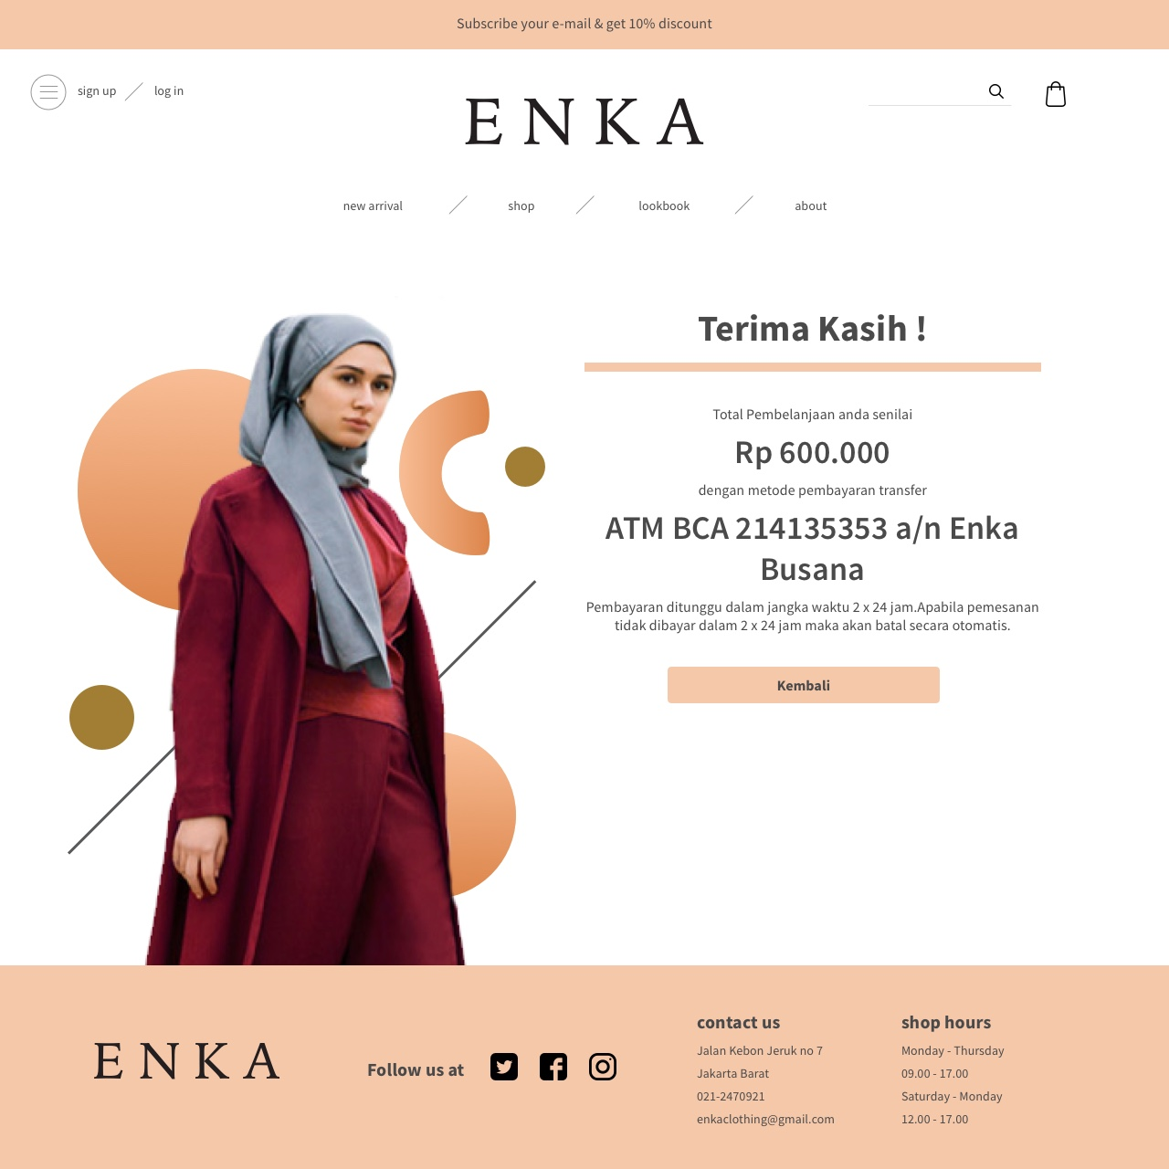

Slide 39
20 ENKA MY HISTORY

Slide 40
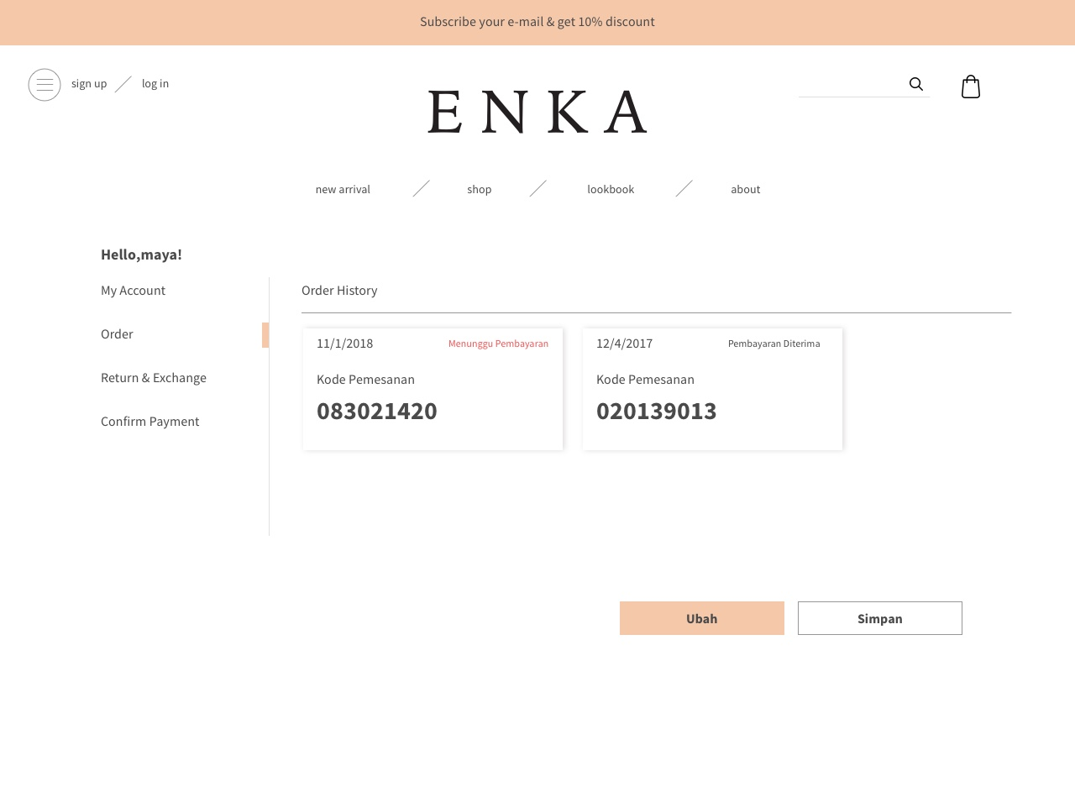

Slide 41
21 ENKA CONFIRM PAYMENT

Slide 42
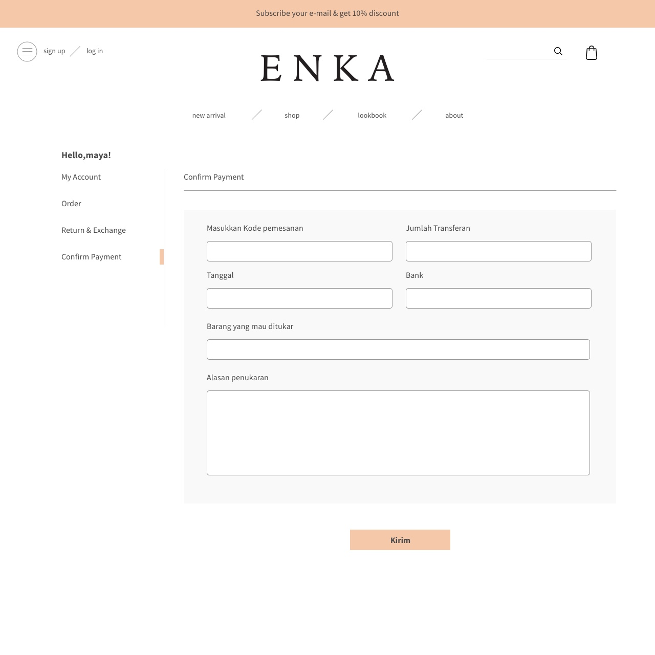

Slide 43
22 ENKA RETURN & EXCHANGE

Slide 44
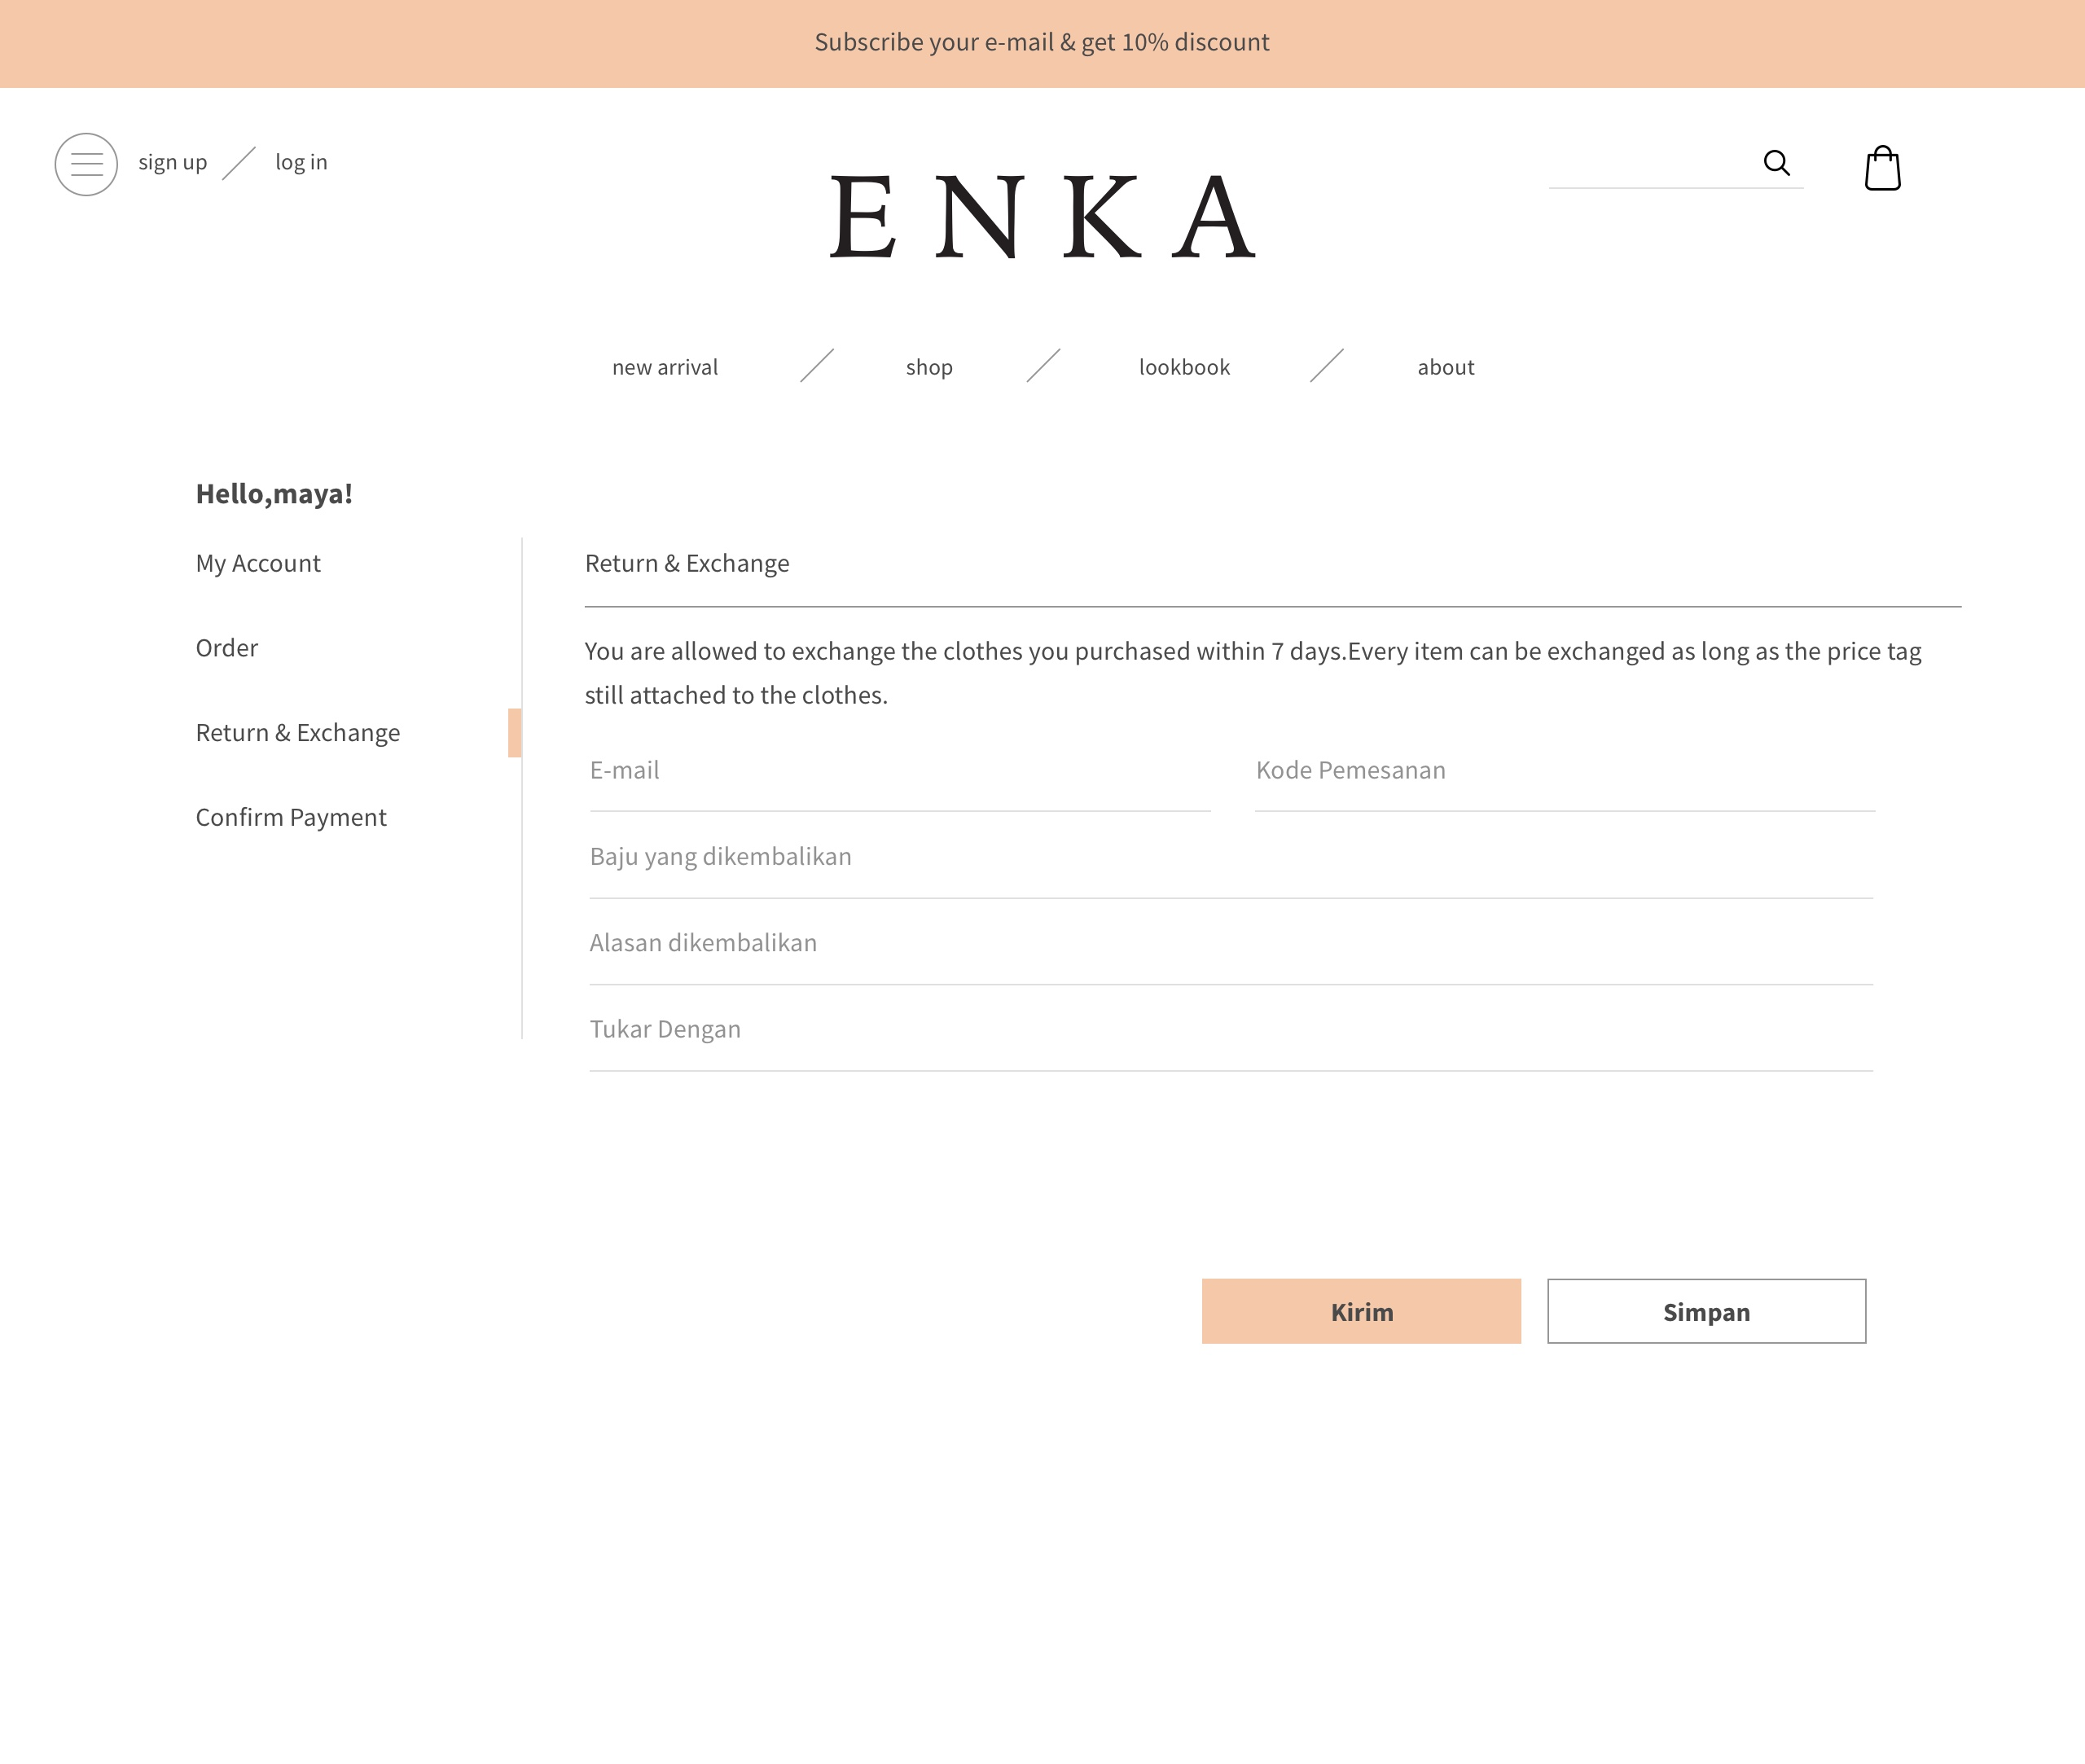

Slide 45
Thank you setelah konfirmasi pembayaran.
Selaraskan logo dan font nya
Wishlist
Back in stock alert
Display apabila size tidak tersedia
Button check out & continue shopping (button remove diganti)
Penambahan CLICK HERE IF THIS ITEM IS A GIFT (PADA LAMAN CHECK OUT)
PADA ENKA QUOTATION DETAIL (check out) tambahan button remove
penambahan tactical step pada laman checkout
Laman coming soon alert items dengan add email
Laman shipping and return

Slide 46
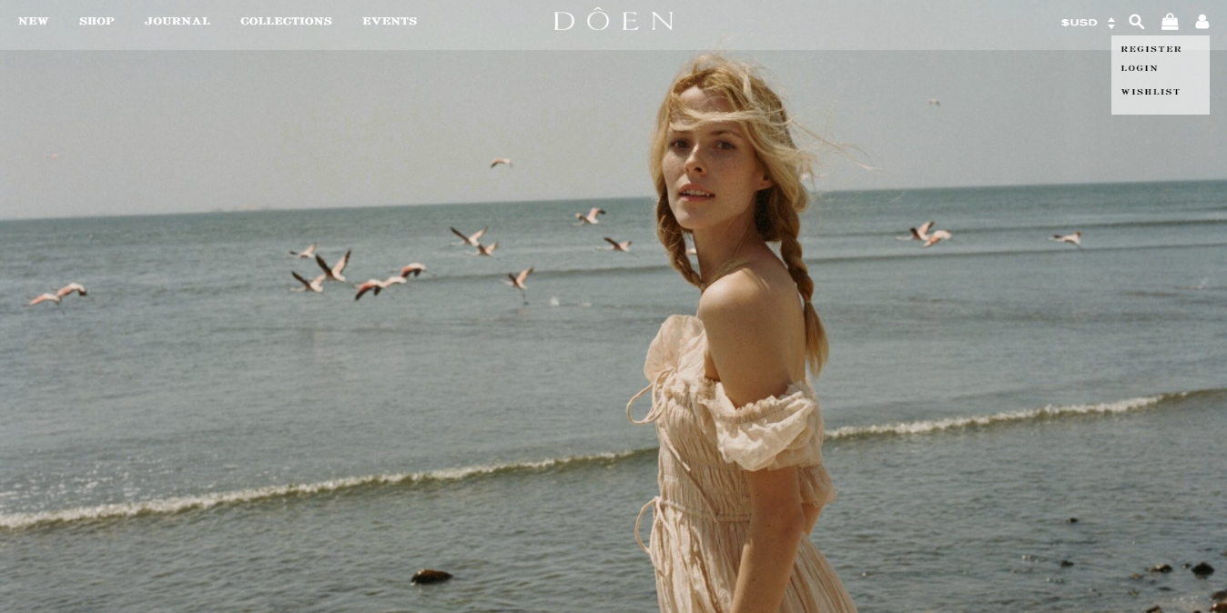
pada laman utama
Register
Log in
Wishlist

Slide 47
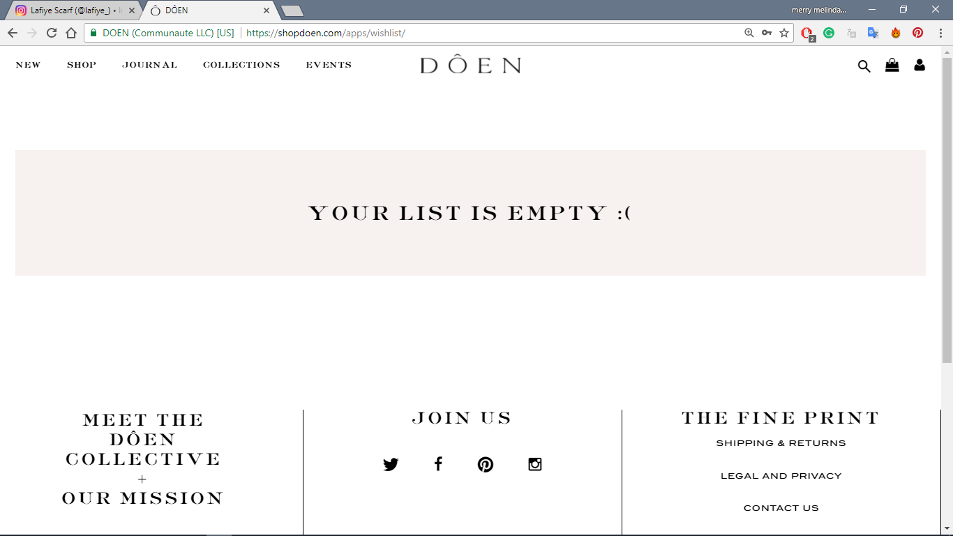
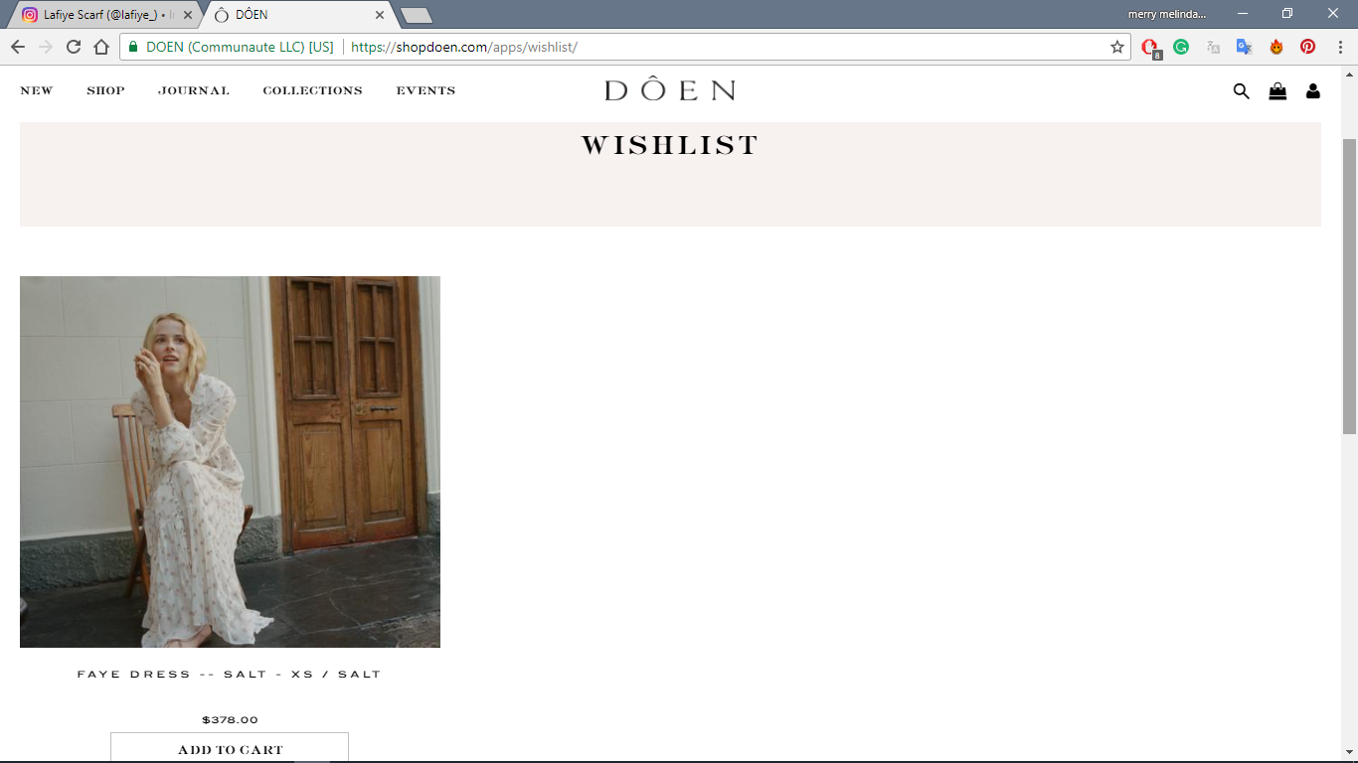
Laman wishlist

Slide 48
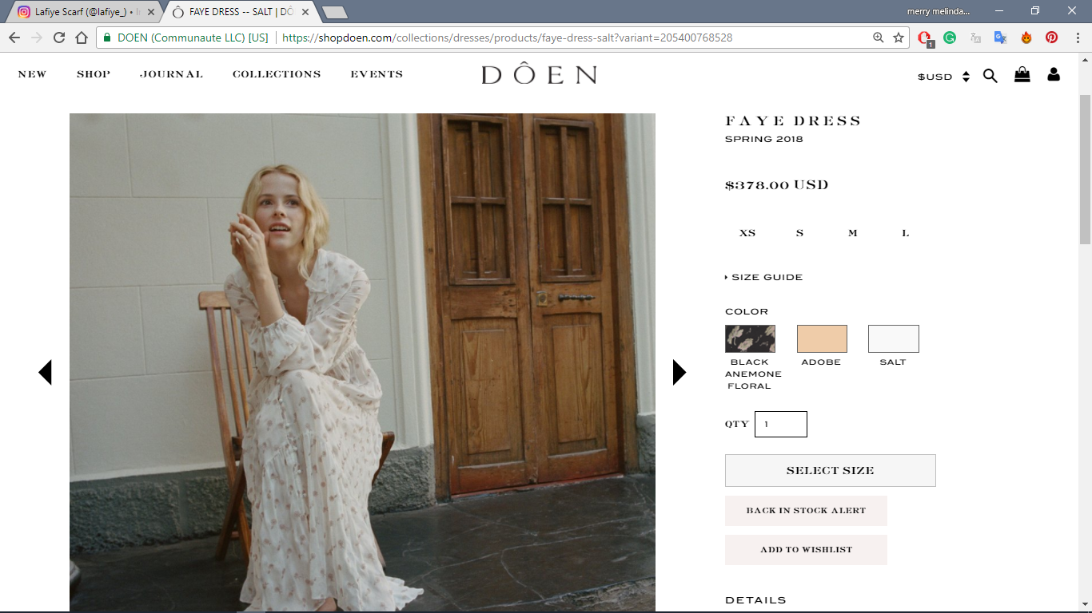

Slide 49
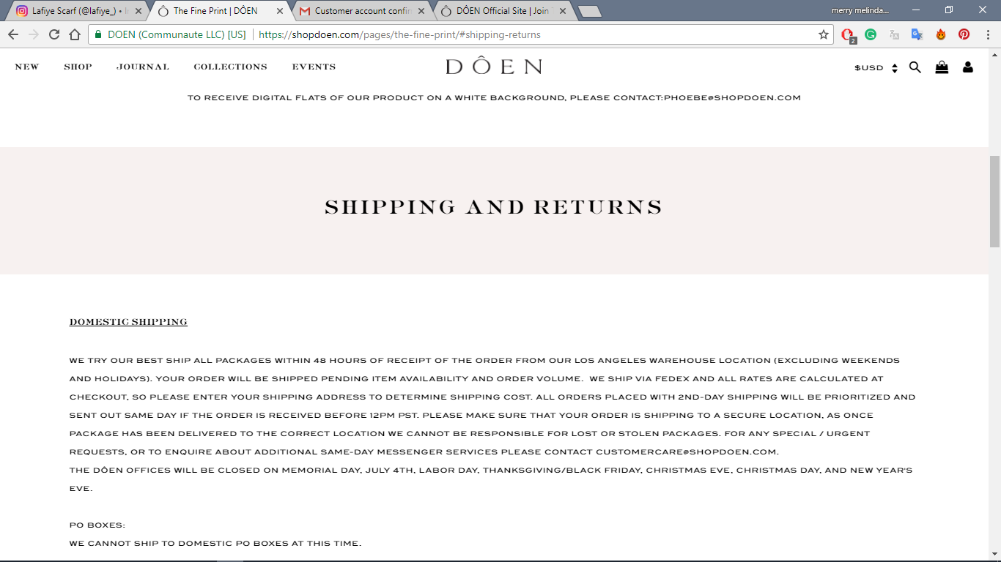

Slide 50
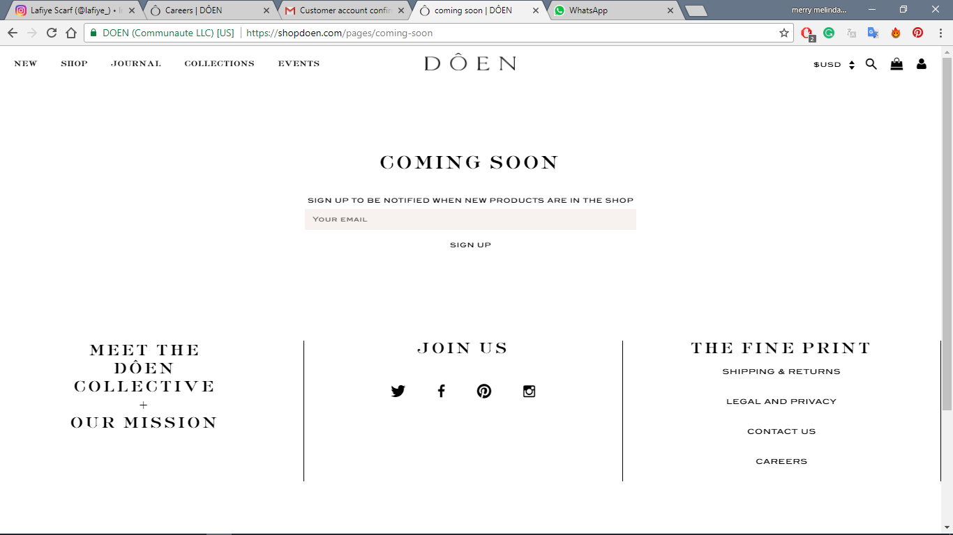
Laman untuk items yang belum tersedia/akan restocks

Slide 51
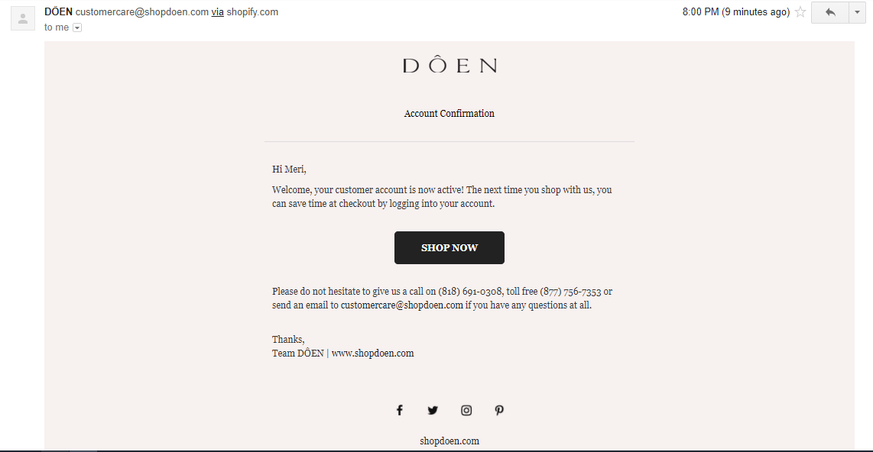
Display email setelah melakukan register

Slide 52
